Slide 1
Effective Email Writing
College English 4

Slide 2
Objectives
To familiarize you with vocabulary you will need to know when talking about emails
To provide you with models of what a well written email should look like
To make you aware of the differences between appropriate and inappropriate tone and register
To review proper paragraph style

Slide 3
Subject
The subject gives the point of your email. It has the same function as a title.
Be specific!
When you receive further correspondence, the subject will become “Re:____________”. What does “Re:”mean?
Regarding
DO NOT WRITE IN ALL CAPITAL LETTERS!

Slide 4
Greetings: Informal
Hey there!
Hello
Hi

Slide 5
Greetings: Semi-formal/Formal
Dear _______________,
Greetings,
Good morning / afternoon,

Slide 6
Body
The body is your message. It begins with a topic sentence.
The topic sentence must be the first line of your e-mail. It tells the reader who you are and what your topic is.
Here are some examples:

Slide 7
Topic Sentences for E-mail
My name is Lee Ji-hye, a College English 4 student in class 05. I missed class on Wednesday, and I would like to request some materials.
This is Park Dong-gyu from your Practical English class that meets on Tuesdays and Thursdays. I am writing to ask several questions about your lecture.
I am Seo Ye-eun who attends your Fundamentals of Academic English class. I would like to discuss something that you mentioned in the lecture on effective email writing on Monday.

Slide 8
Body Paragraph Sentences-1
I am writing to discuss some problems that we are having in our team project.
I am writing to say I really enjoyed the lecture on Friday and was wondering if you have any additional resources on the future of global economics.

Slide 9
Body Paragraph Sentences-2
I am having a hard time with my research question and am wondering if you could steer me in the right direction.
I apologize for missing class and my presentation on Wednesday. Can I schedule an appointment and discuss what happened and what I can do?

Slide 10
Attachments
Include details of any attachments you include. For example:
I have a question about the homework. The paragraph writing handout for the homework 1(attached), says that we should submit it by Friday. However, this is different to the information on the website.
I have attached the following handouts:
No smoking presentation PPT
No smoking presentation script
No smoking poster

Slide 11
Valediction
For the last lines of your e-mail, it is a good idea to say ‘thank you’ to show your appreciation for the the time the professor takes to read and respond to your e-mail.
Thank you for your time. I look forward to hearing from you.
This is followed on the next line by a word or phrase called the valediction, which is the closing of the e-mail. Always put a comma after the valediction. Here are some examples:
All the best, Regards, Warm regards, Warmly, Sincerely,
Write your name under the valediction.
Add your contact information under your name.

Slide 12
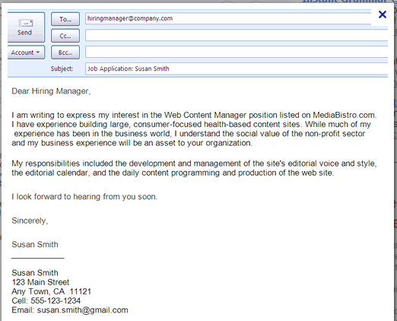
E-mail Vocabulary
Subject Line
Greeting
Body/Content
Valediction
Sender’s contact
information

Slide 13
The Bad & The Good
Hi teacher!!!!!! :-) Sorry,
As New employment, I DONT HAVE VACATION!!!!!! :-( coz my boss is crazy
so, I don't go uni 2017/12/9~12/13. So I wanna take exam 2017/12/14. OK?
you understand?. Please understand my situation. T.T
BTW email me your answer soon! I’m waiting your answer.
I go swimming now with my gf.
Have a nice day!!!
Dear Mr. Ericson:
My name is Park Dong-hyun, and I am enrolled in your Monday morning 9:00 College English 3 class.
I have recently been hired by Samsung and am unable to attend your class from December 9 to 13. I have a few questions concerning my situation.
1. Is it possible for me to take the exam on December 14?
2. Would you consider doing the exam through Skype?
3. Could I complete a written assignment in place of the
speaking exam?
Thank you in advance for considering my request.
Best regards,
Park Dong-hyun

Slide 14
Do
Don’t
Use an informative subject line that states what the email is about.
Write the most important information first.
Use numbers and bullet points to make the message clear.
Use simple grammar.
Write short sentences.
Use proper paragraph structure to keep the email clear and easy to understand.
Write ‘hi’ or ‘hello’ in your subject line, or as a salutation.
Write about irrelevant issues.
Give confidential or personal information that you don’t want others to know.
Use capital letters to write whole words.
Use exclamation marks excessively.
Use abbreviations like coz or uni, as these may not be understood.
Use acronyms like BTW
Use emoticons. They may be misunderstood and come across as immature.

Slide 15
The Perfect E-mail: Seven Rules to Write By
1. | Ideas | Clearly stated reason for writing The message talks directly to the receiver Answers all questions
2. | Organization | Salutation Ideas in body presented in a logical order Closing
3. | Voice | Clear tone Polite
4. | Word Choice | Business etiquette Plain English
5. | Sentence Fluency | Maximum 20 words per sentence. Don’t repeat sentences
6. | Conventions | Correct grammar and spelling Correct capitalization and punctuation No emoticons or funny symbols
7. | Presentation | Completed fields (e.g. subject line) Good line spacing; use short paragraphs Easy to scan

Slide 16
Email Project
Write a formal email to your teacher and ask him or her about some important information you would like to know. keithathallym@gmail.com
Follow the correct e-mail format you learned in this class.
Use the proper tone and register when composing your e-mail.
Your e-mail should include 3 paragraphs. The body should be between 100 and 150 words long.
It should include some form of attachment.
E-mail subject line: CE4 (05) Park Ji-hyun Email Project

Slide 17
Formal E-mail Example
To: richericson@hallym.ac.kr
Subject: Request for Alternate Exam Date
Dear Dr. Ericson:
My name is Park Dong-hyun, and I am enrolled in your Monday morning 9:00 College English 3 class.
I have recently been hired by Samsung and am unable to attend your class from December 9 to 13. I have a few questions
concerning my situation.
1. Is it possible for me to take the exam on December 14?
2. Would you consider doing the exam through Skype?
3. Could I complete a written assignment in place of the speaking exam?
Thank you in advance for considering my request. I look forward to hearing from you soon.
Best regards,
Park Dong-hyun
Park Dong-hyun
107-605 Lovely Apartments
Unreal-dong, Chuncheon 24567
Phone: 010-555-5678
Email: parkranger@tmail.com

